Slide 1

National Service Scheme
Special Camp-2025
12th Jan to 18th Jan 2025
Location:- Loni Kalbhor Village

Slide 2
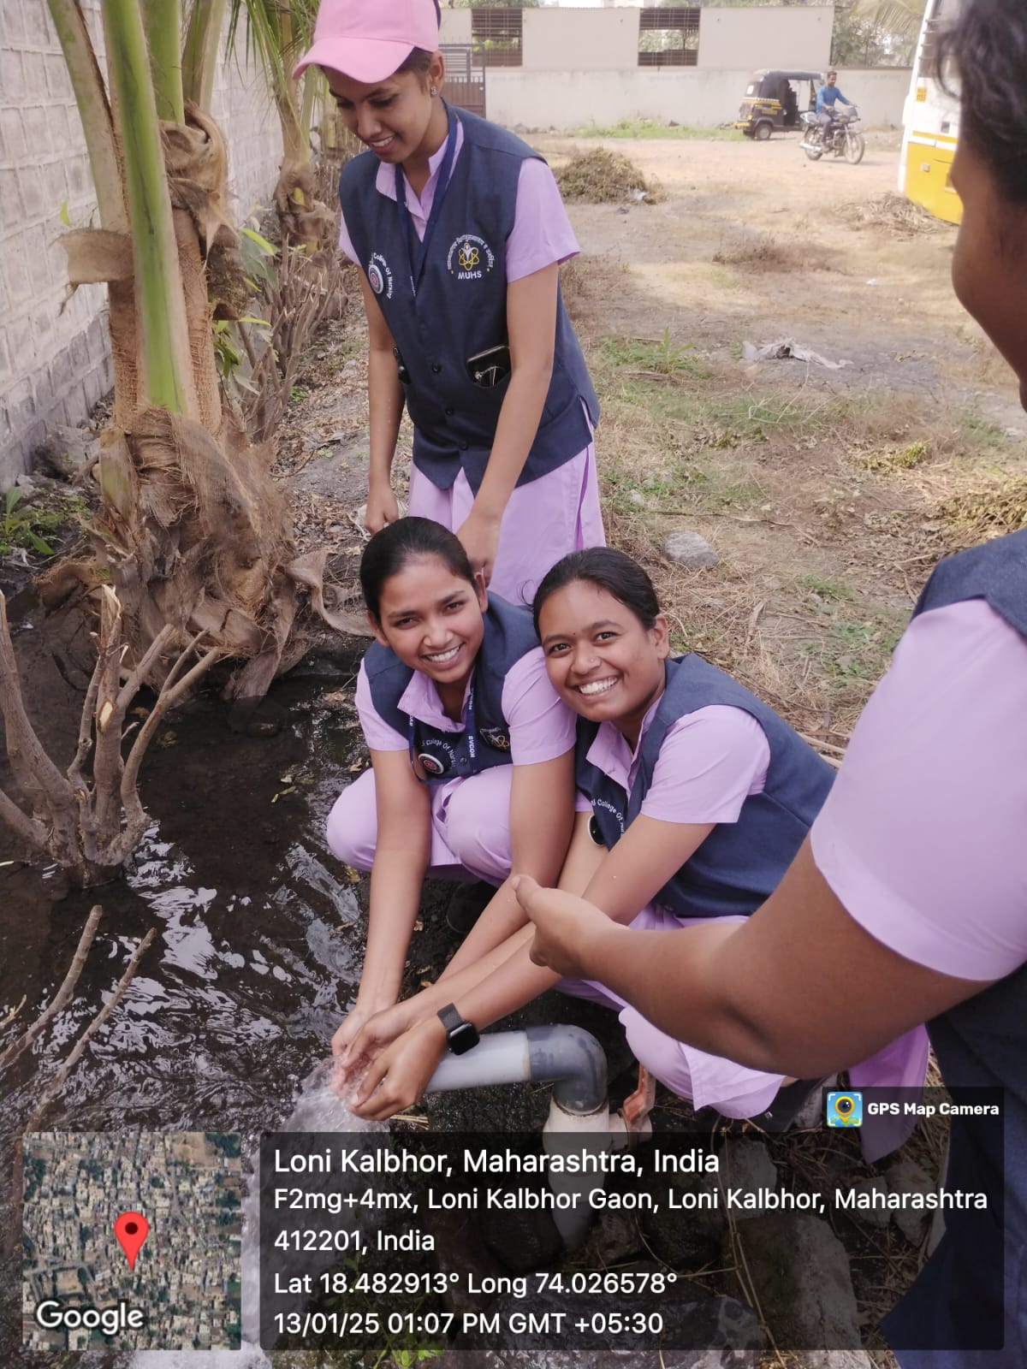
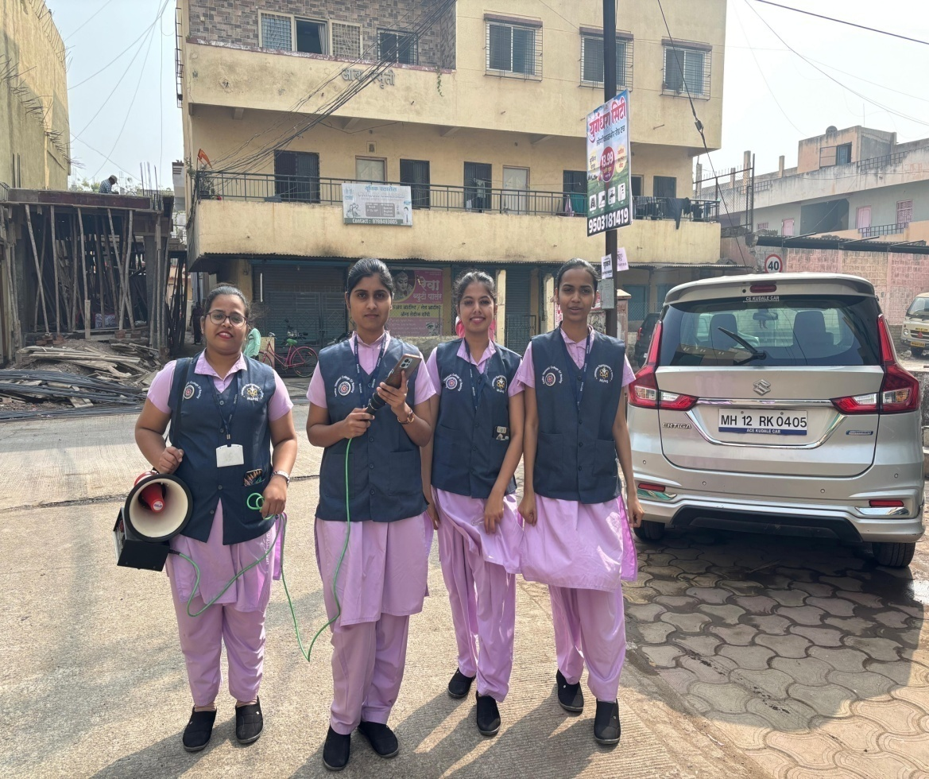
Day 1st -12/01/2025
Reaching village and settlement & propaganda

Slide 3
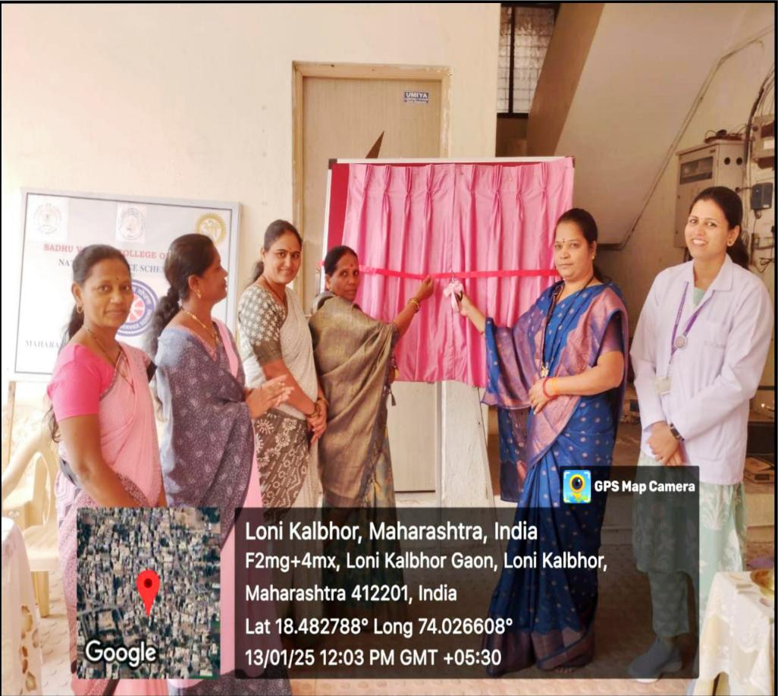
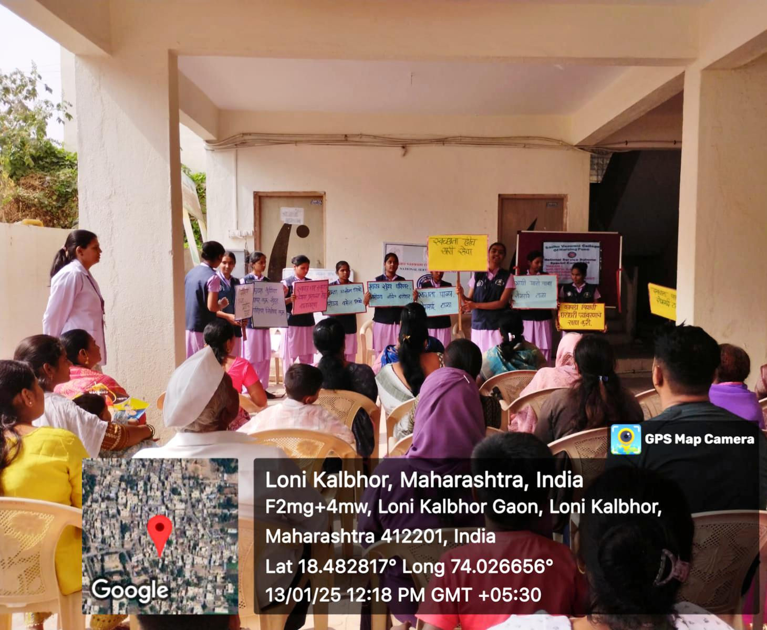
Day 2nd-13/01/2025
Theme inauguration
Role play on Environment sanitation

Slide 4
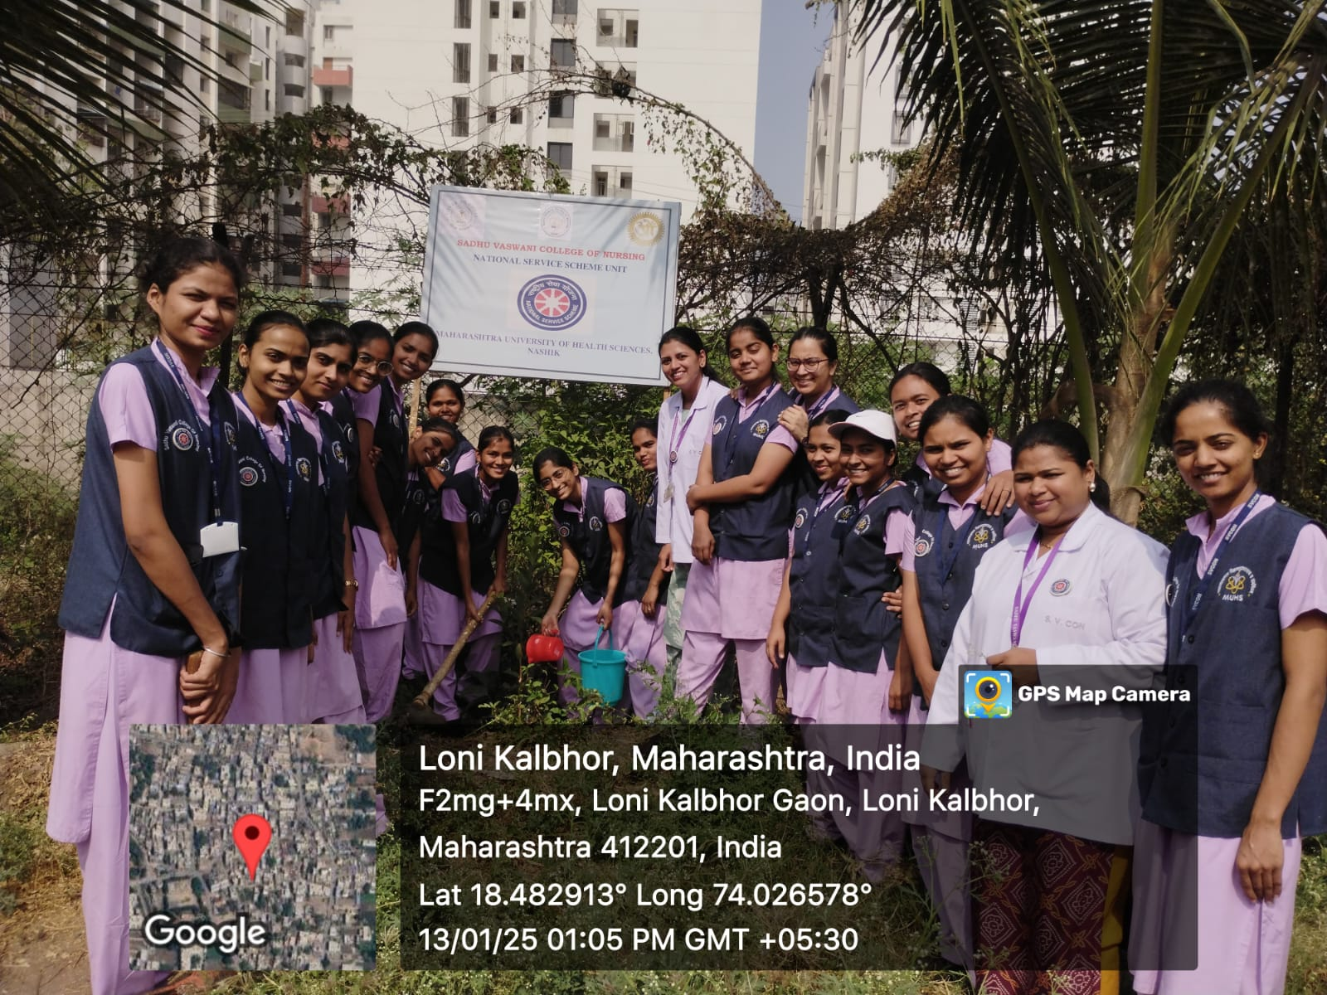
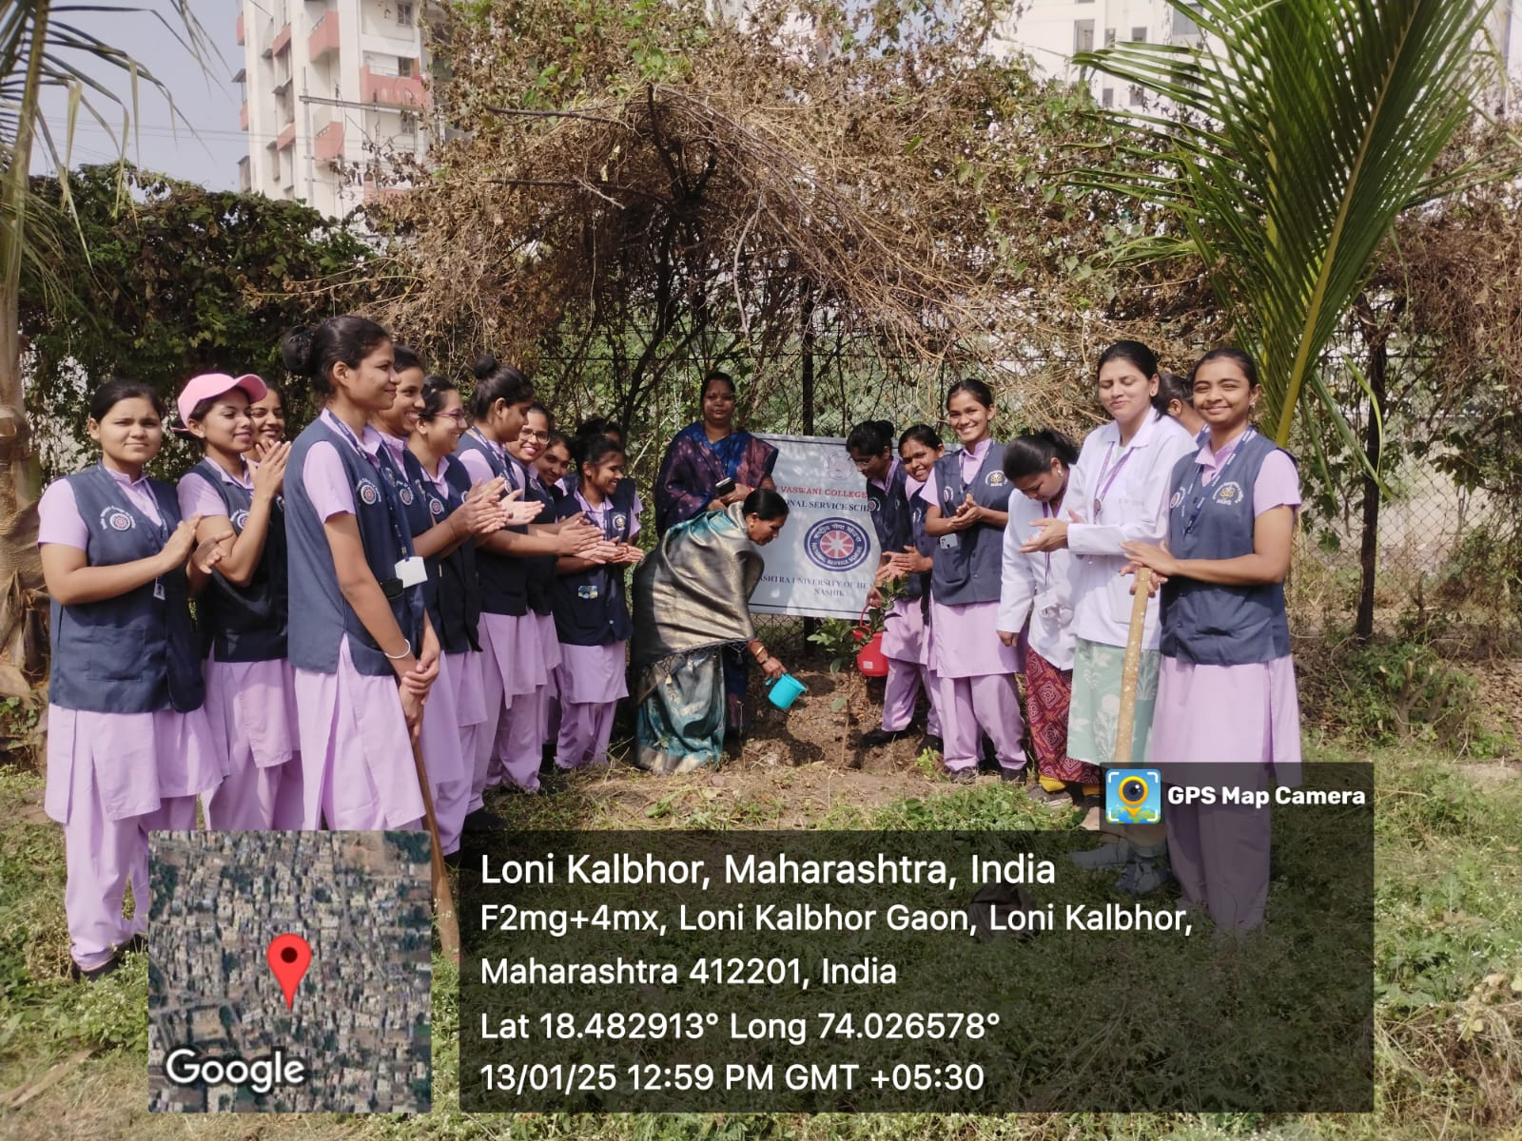
Tree plantation at Loni Kalbhor

Slide 5
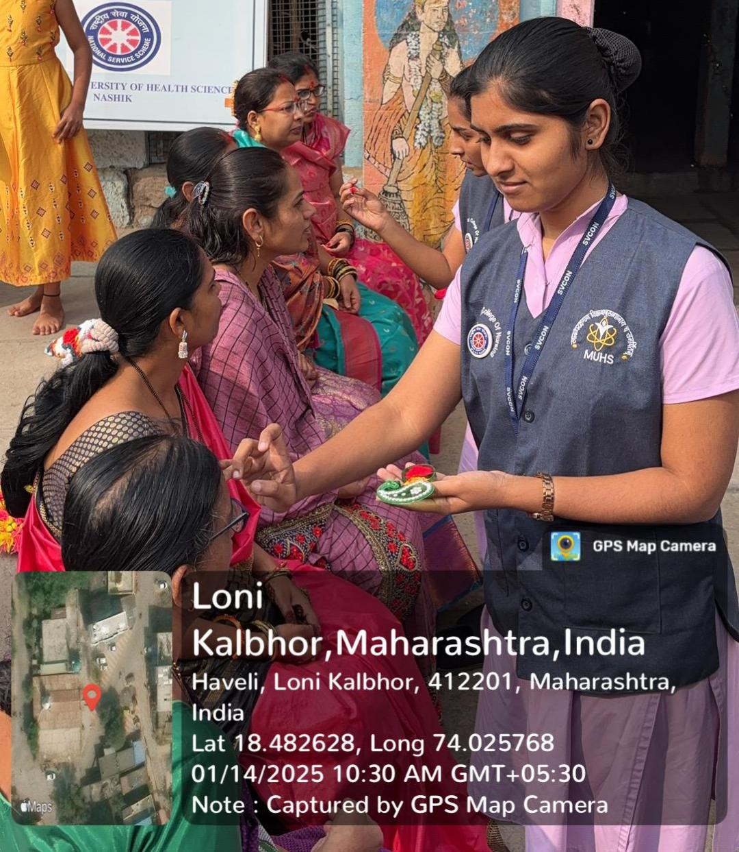
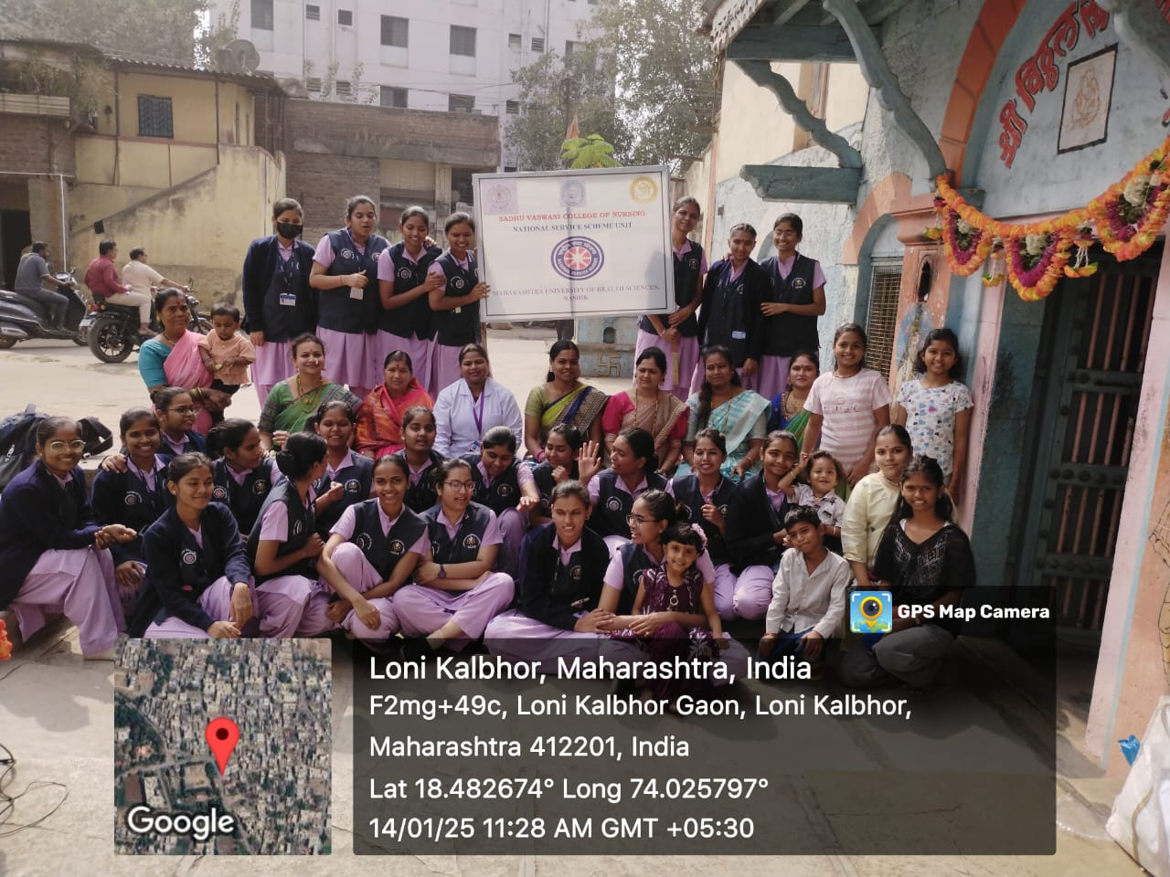
Day 3rd -14/01/2025
Haldi-kumkum program & Health education for women

Slide 6
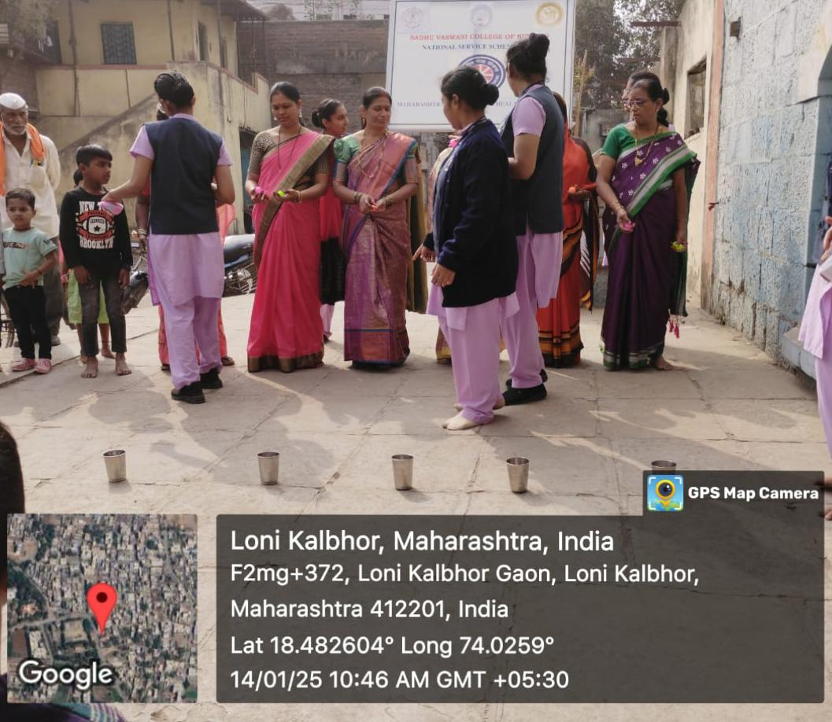
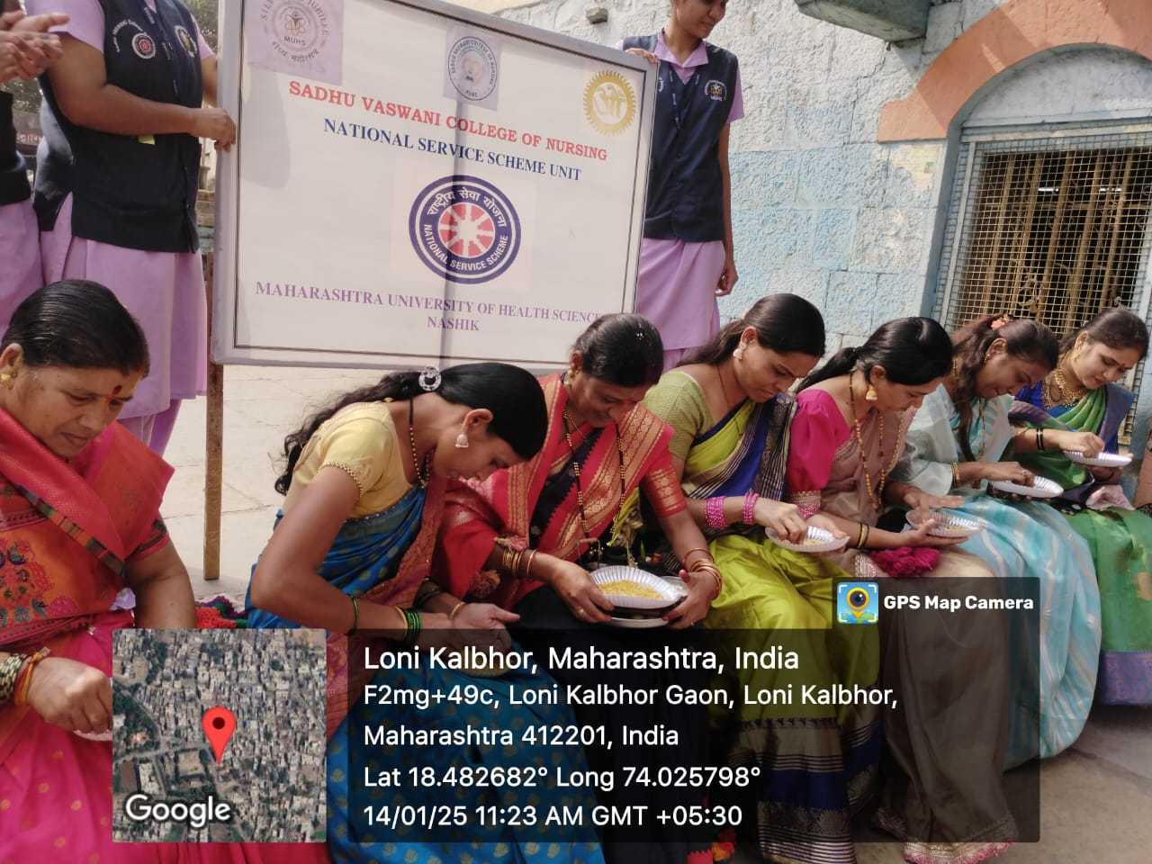
Games for Women

Slide 7
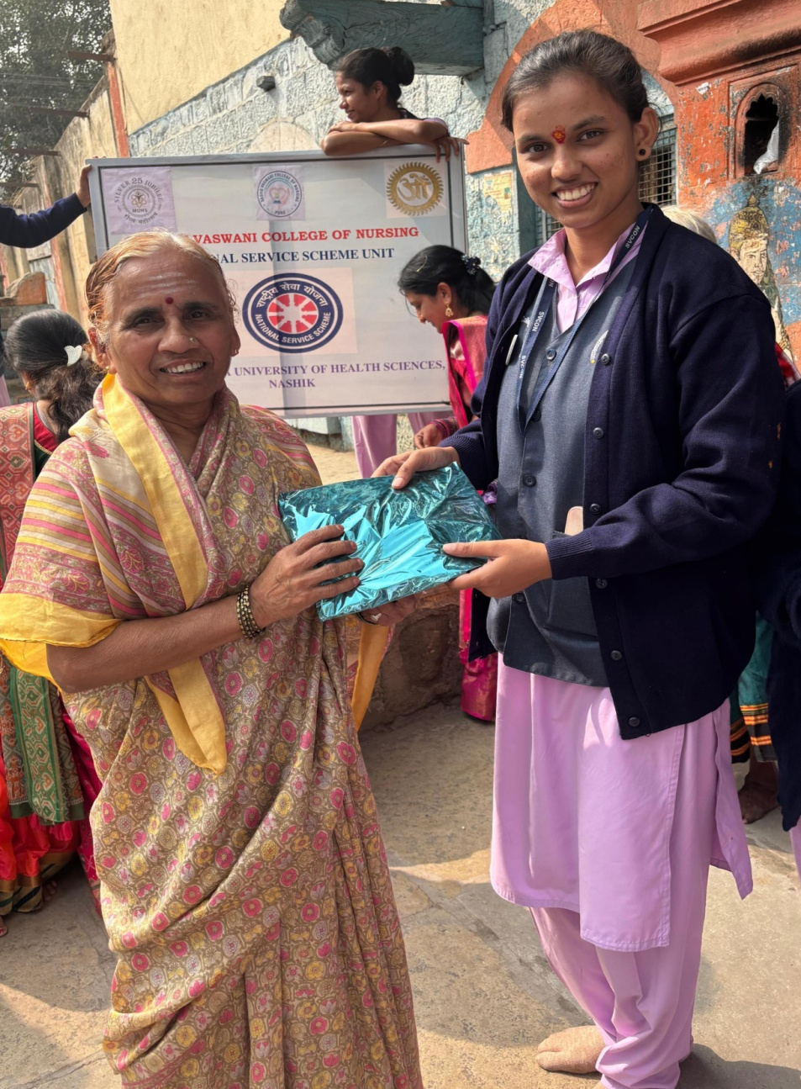
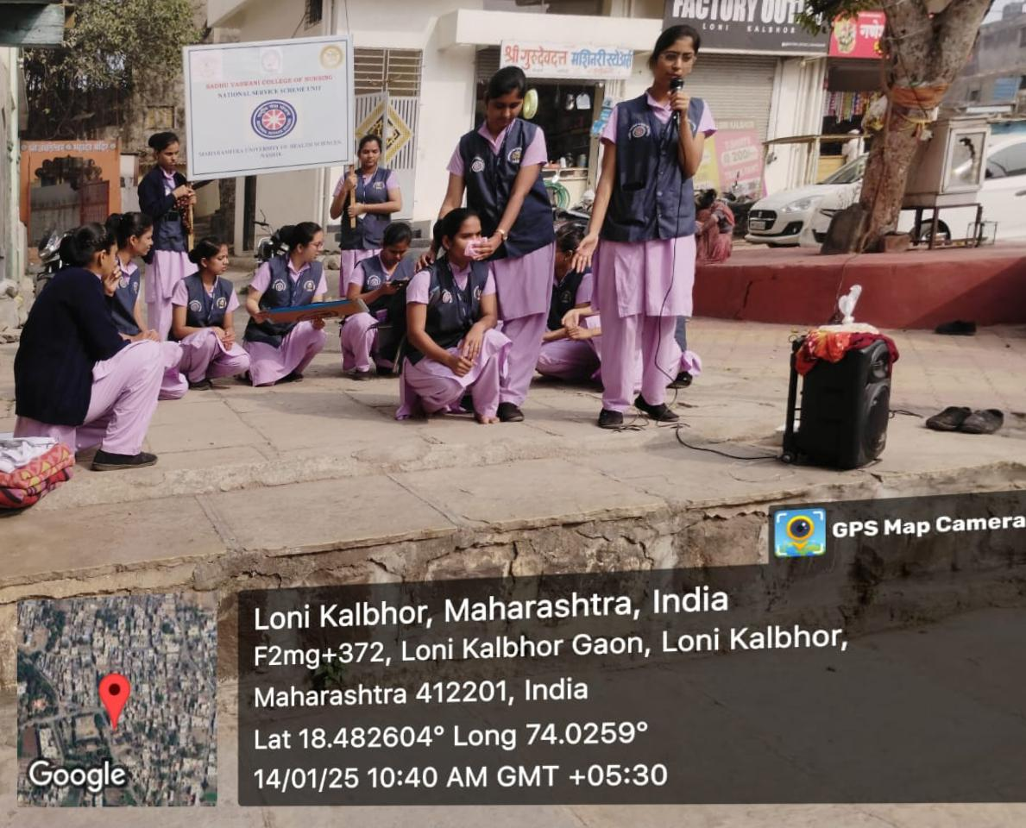
Street play on Laws for women safety & empowerment
Prize distribution

Slide 8
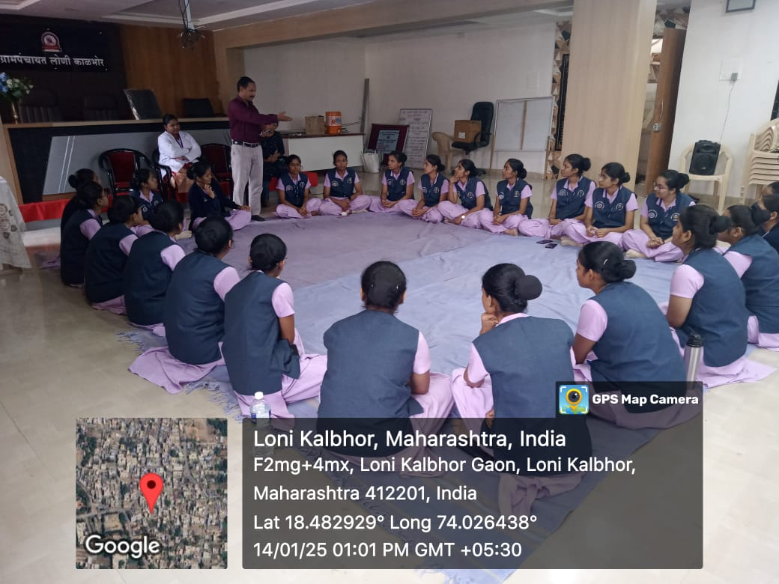
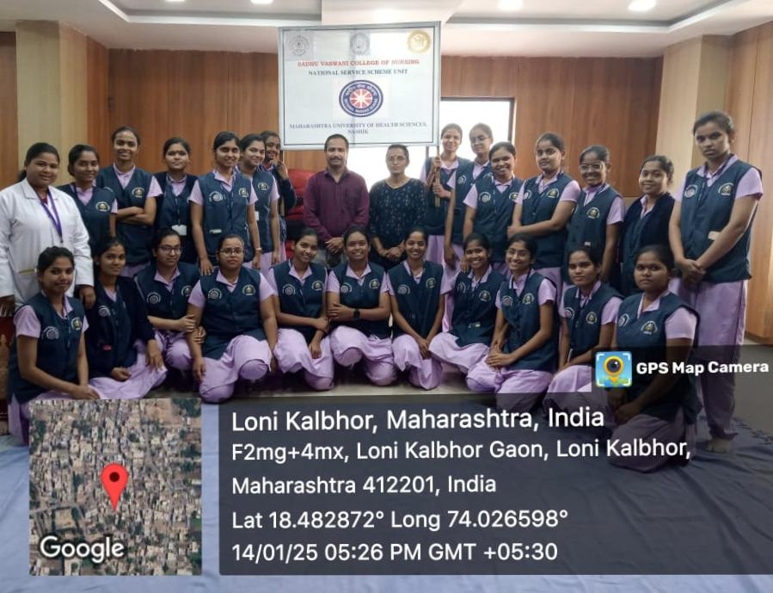
Guest lecture on cyber crime prevention

Slide 9
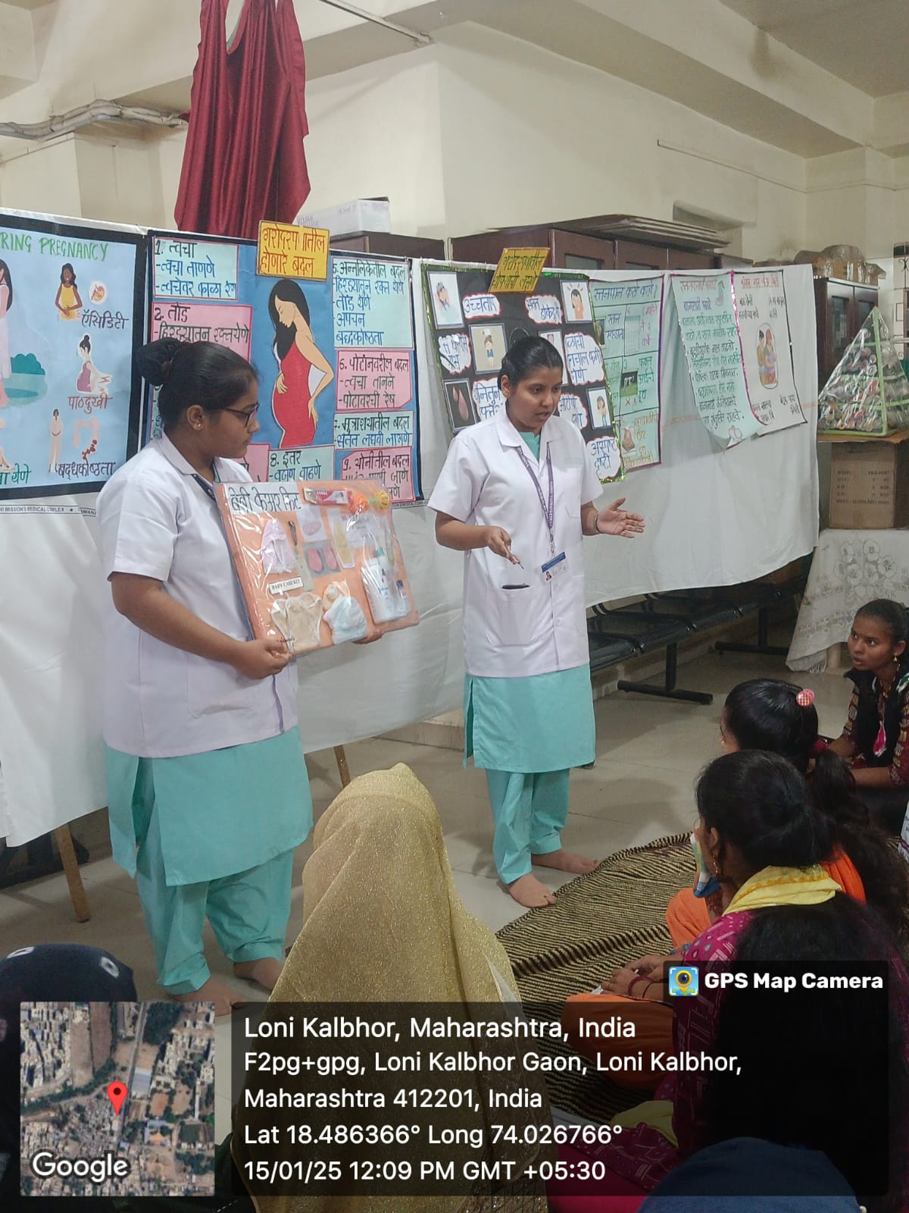
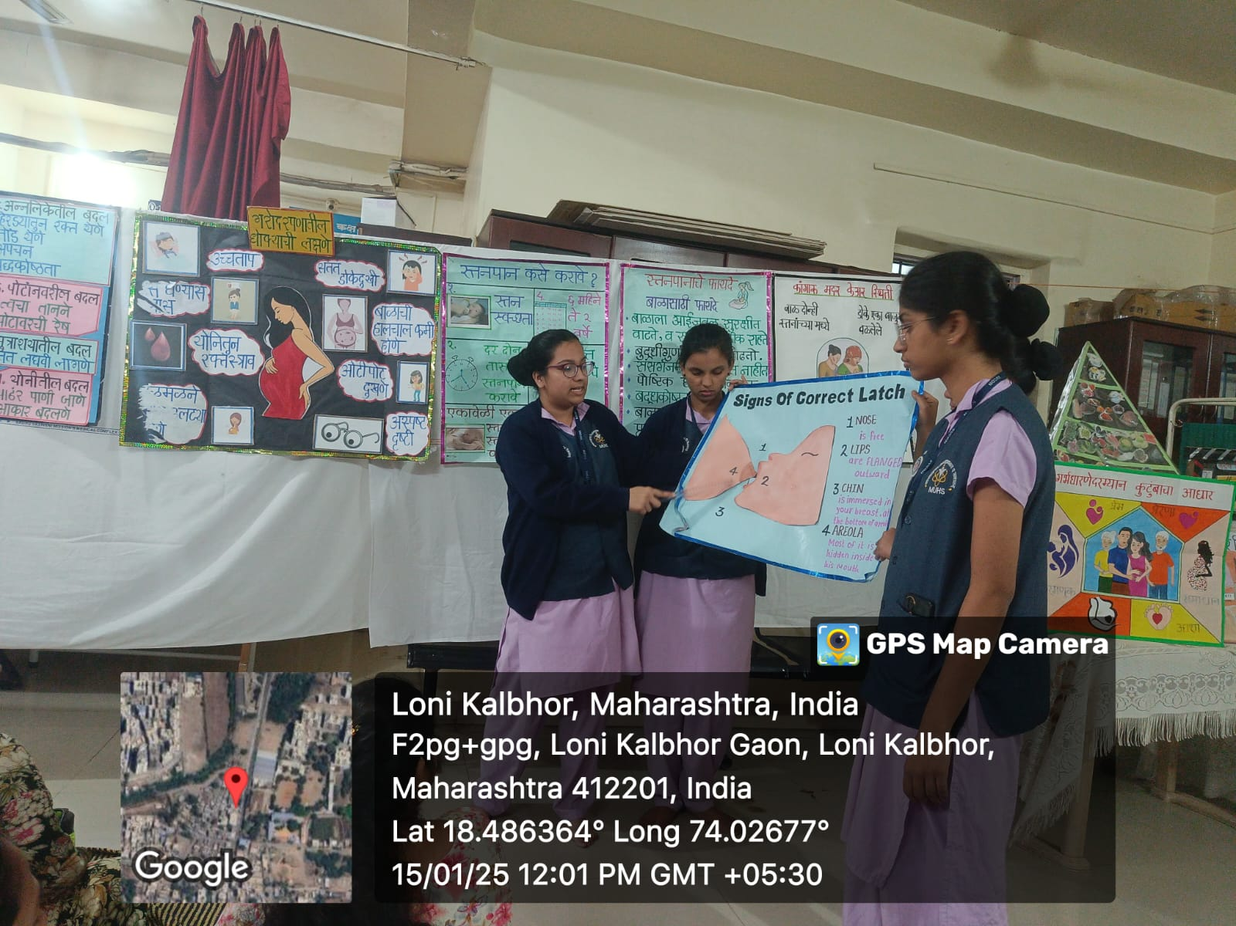
Day 4th – 15/01/2025
Health exhibition for ANC mothers

Slide 10
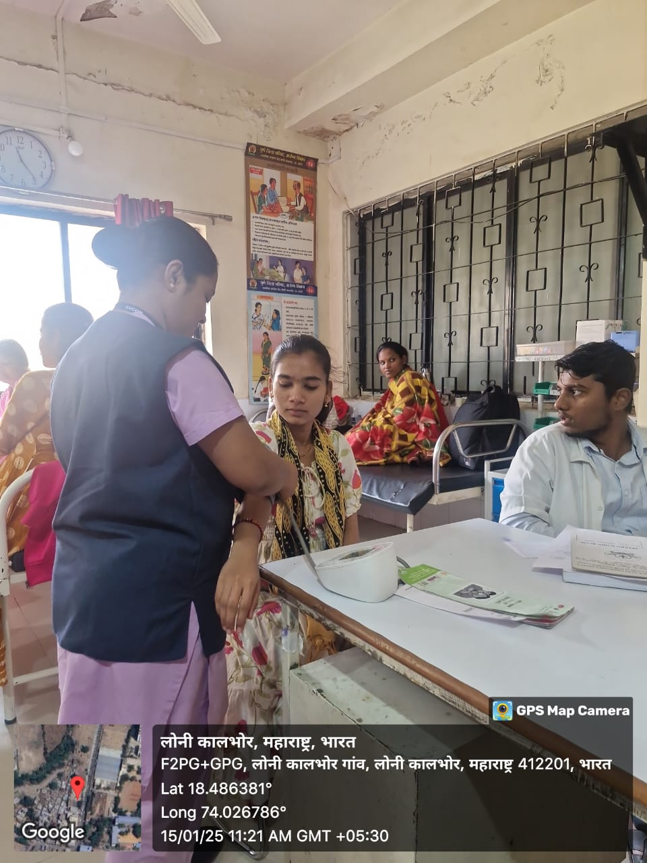
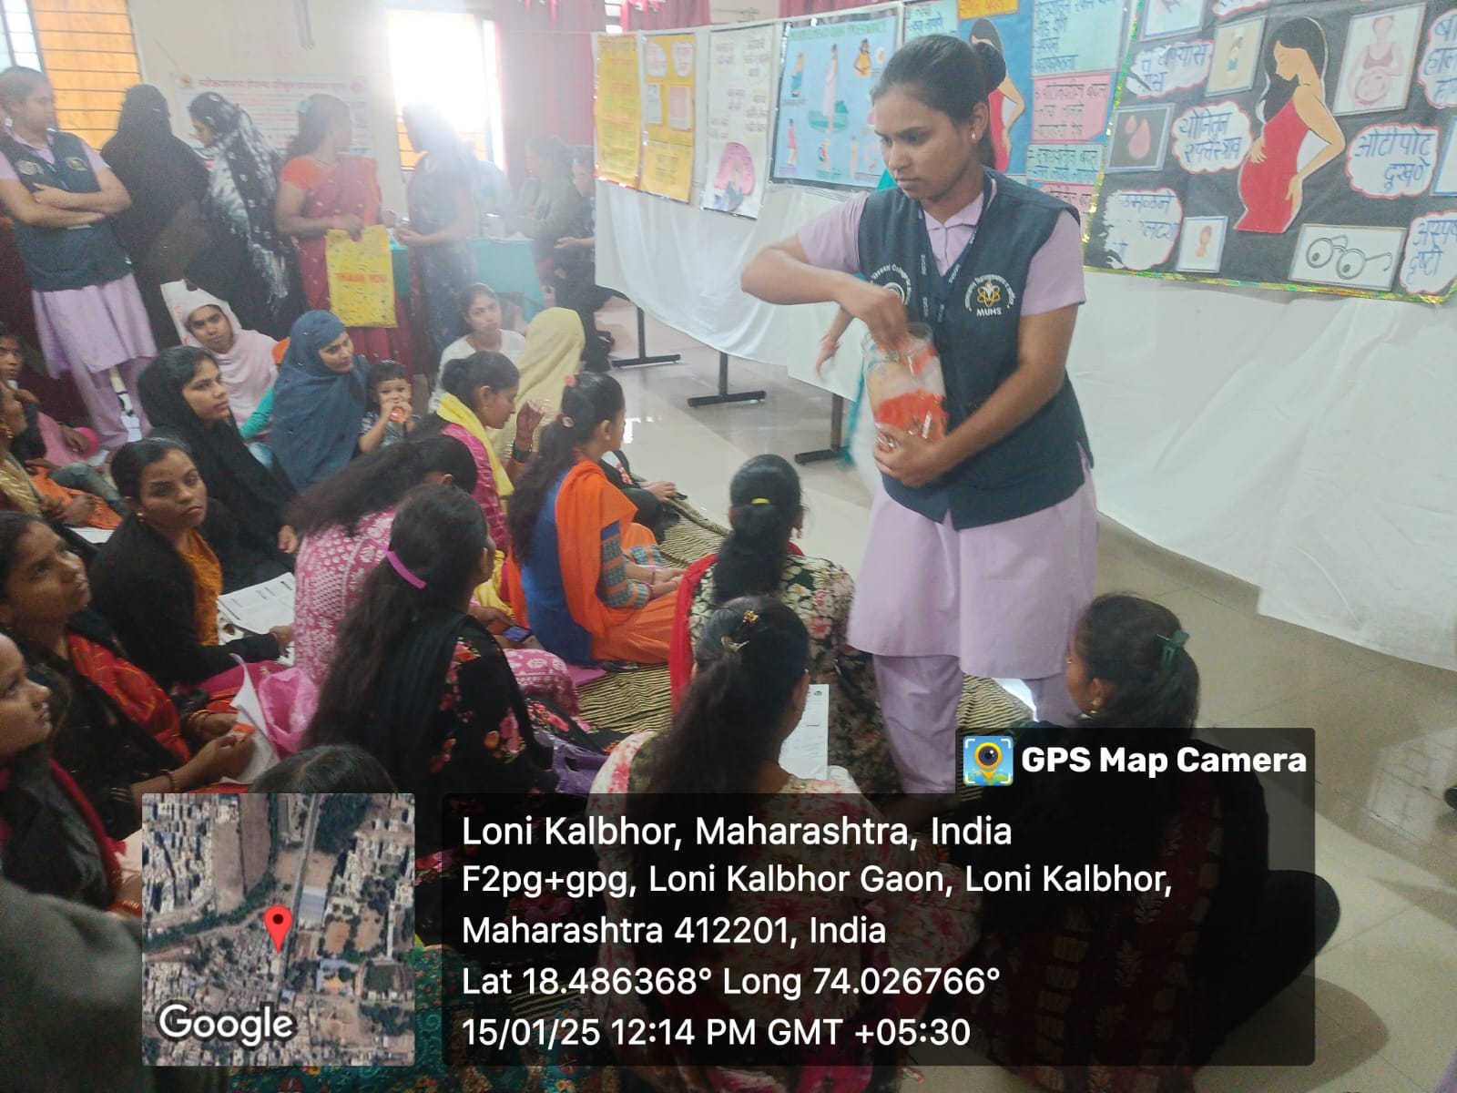
ANC Assessment
Chikki distribution for ANC mothers

Slide 11
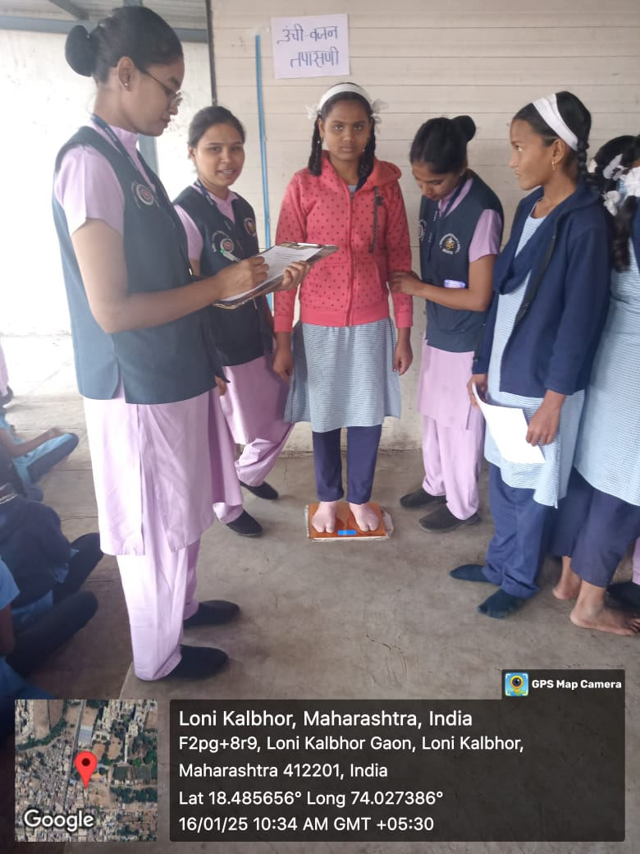
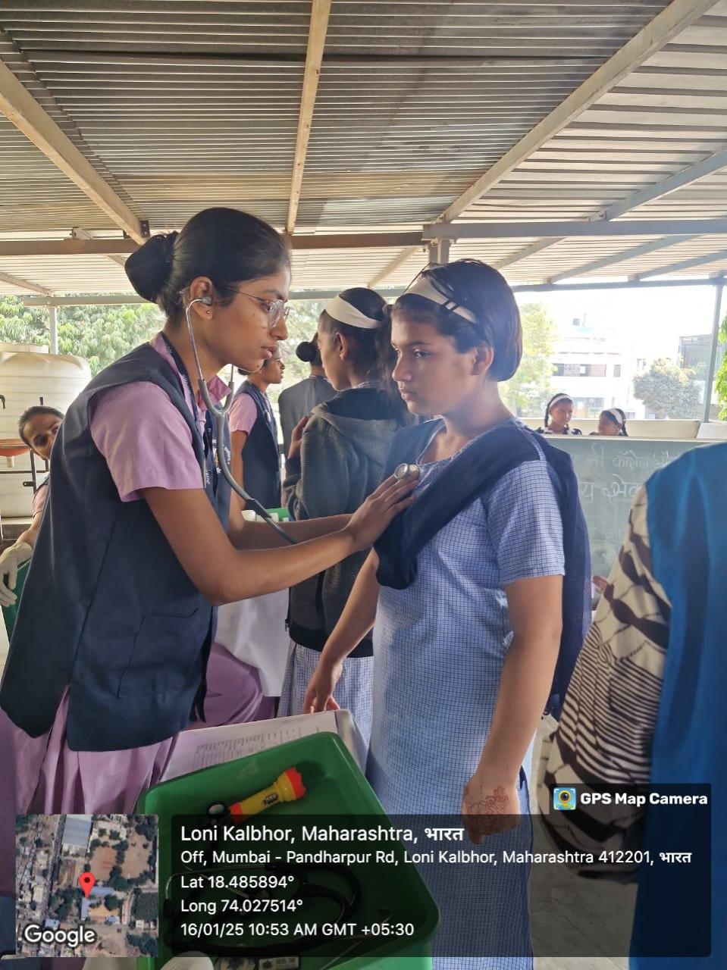
Day 5th -16/01/2025
School Health programme
BMI assessment
Physical examination

Slide 12
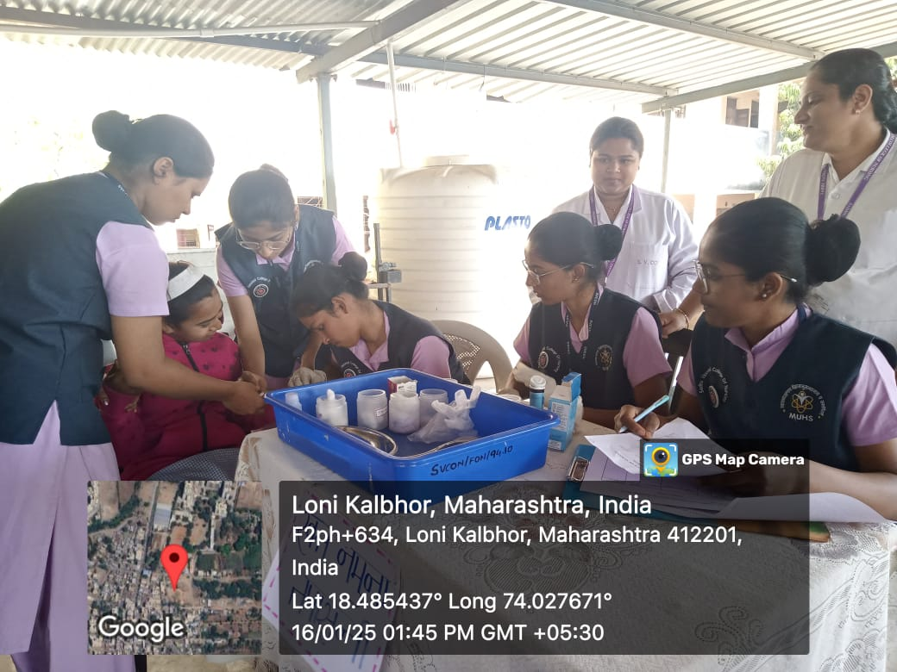
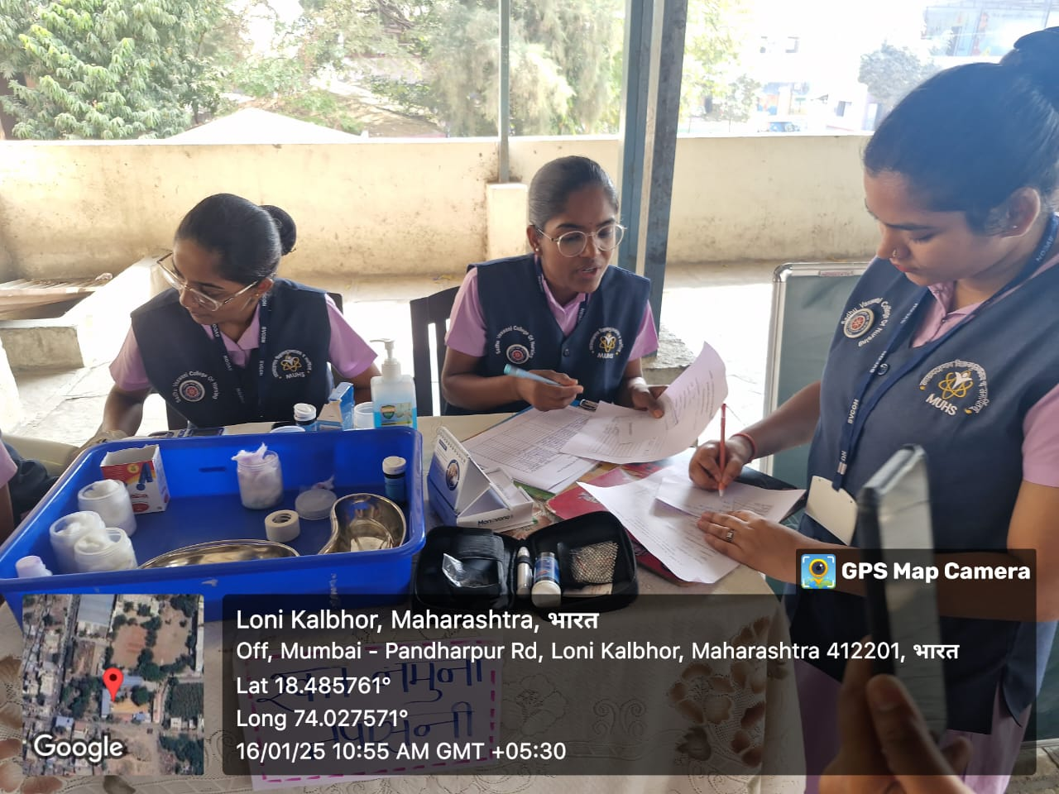
Haemoglobin test

Slide 13
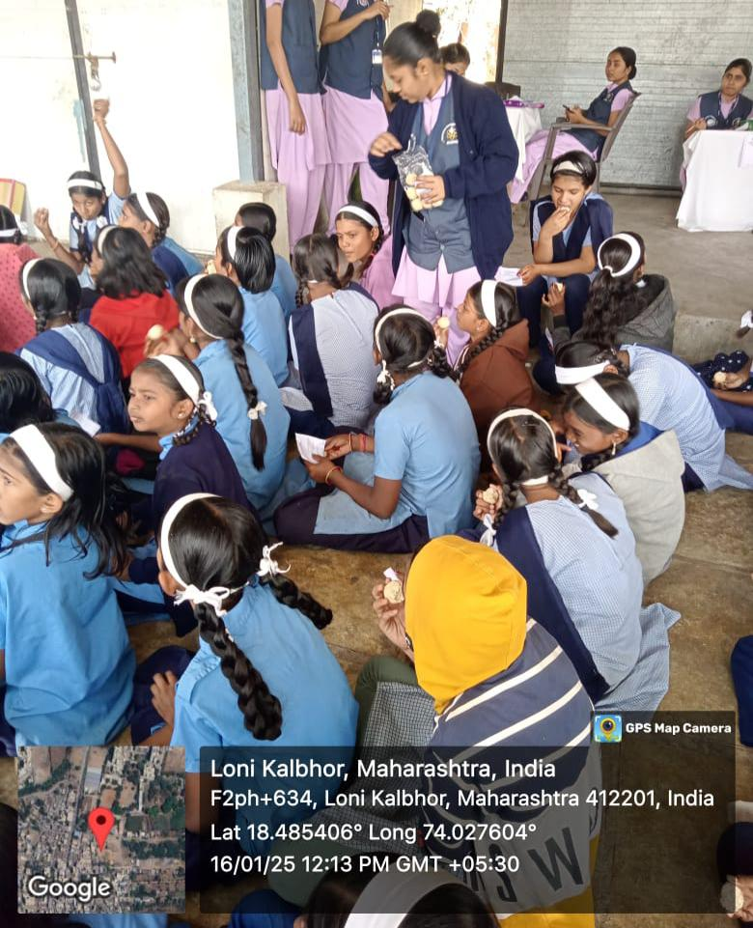
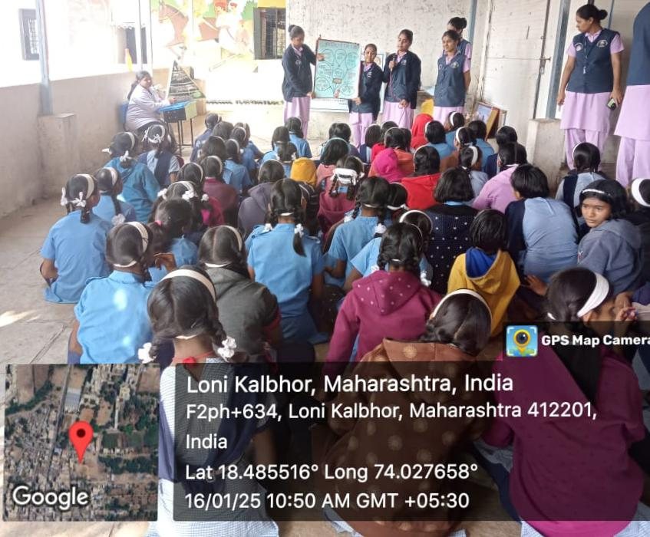
Rajgira ladoo distribution
Health education for children

Slide 14
Haemoglobin Estimation Report
Sr. No | Hb Range | Inference | Total no. of girls
1 | >12gm/dl | Normal | 13
2 | 10-12 gm/dl | Mild anaemia | 57
3 | 7-9.9 gm/dl | Moderate anaemia | 07
 |  | Total No. Of girls | 77

Slide 15
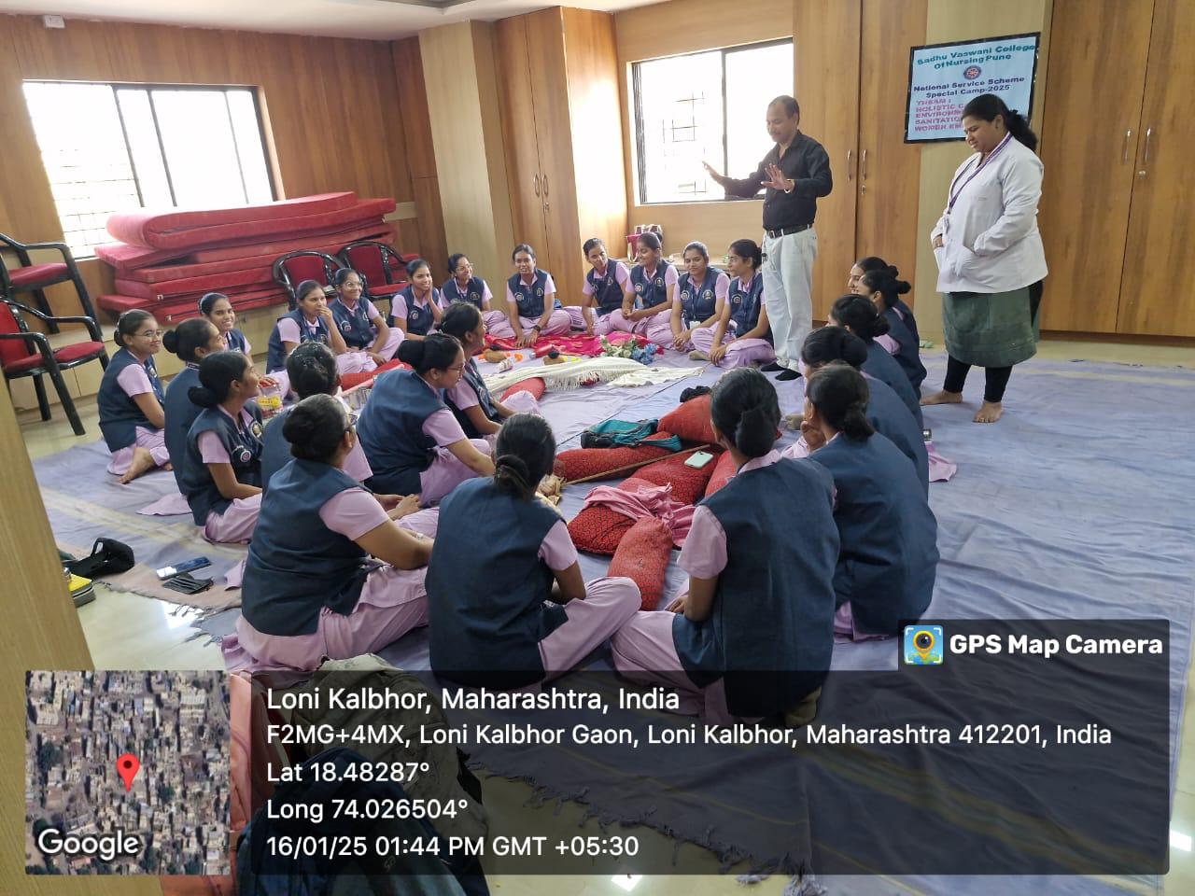
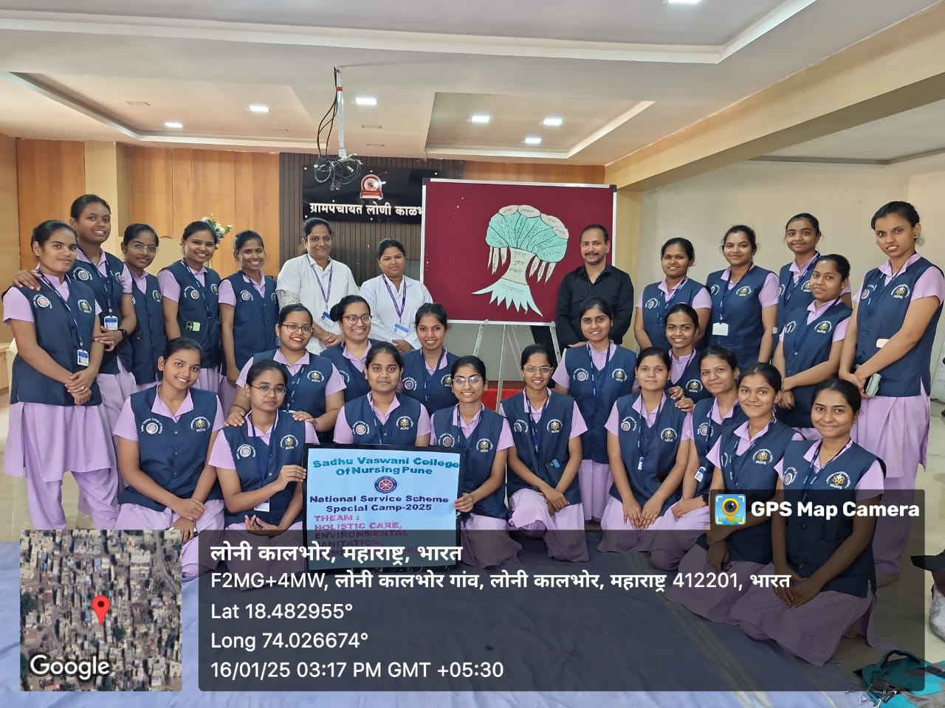
Guest lecture on Gender Equality

Slide 16
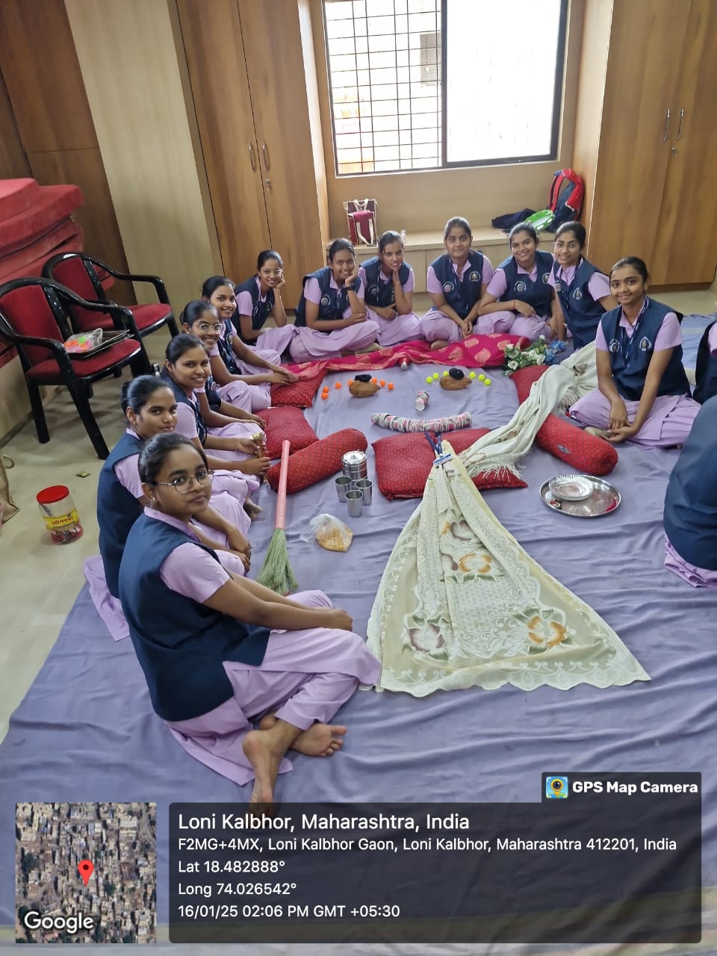
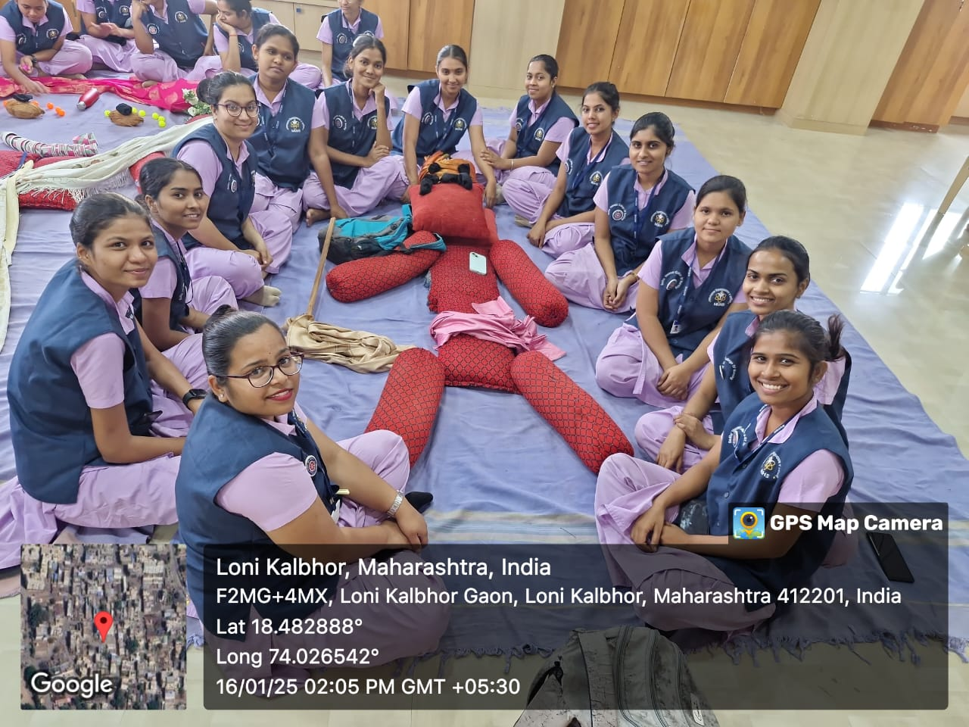

Slide 17
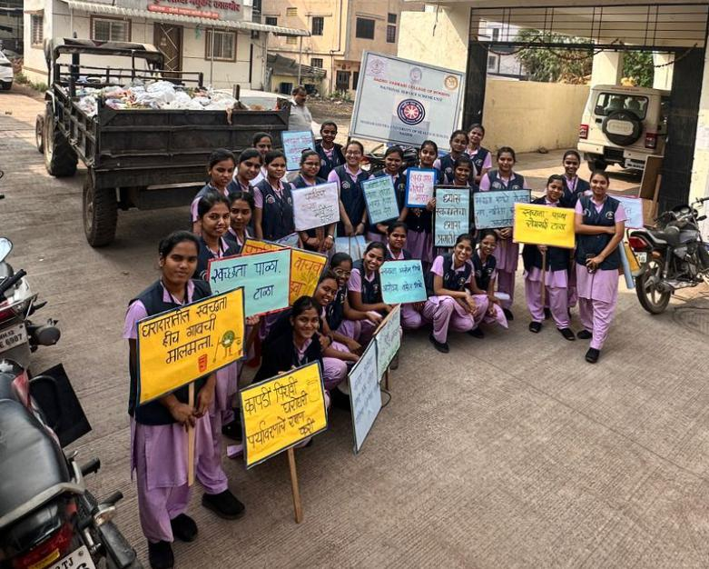
Day 6th -17/01/2025 Swacchata Abhiyan
Rally on Environment sanitation

Slide 18
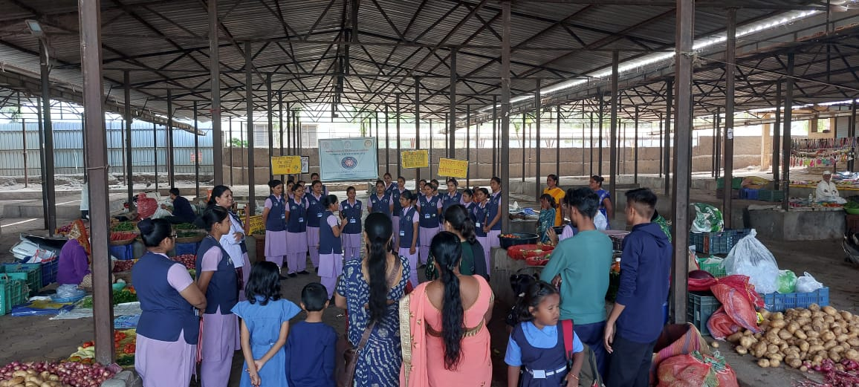
Street play on environment sanitation at Market area

Slide 19
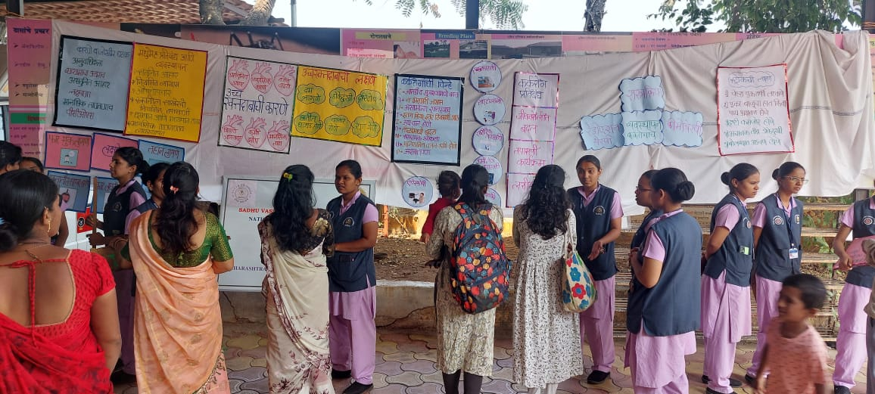
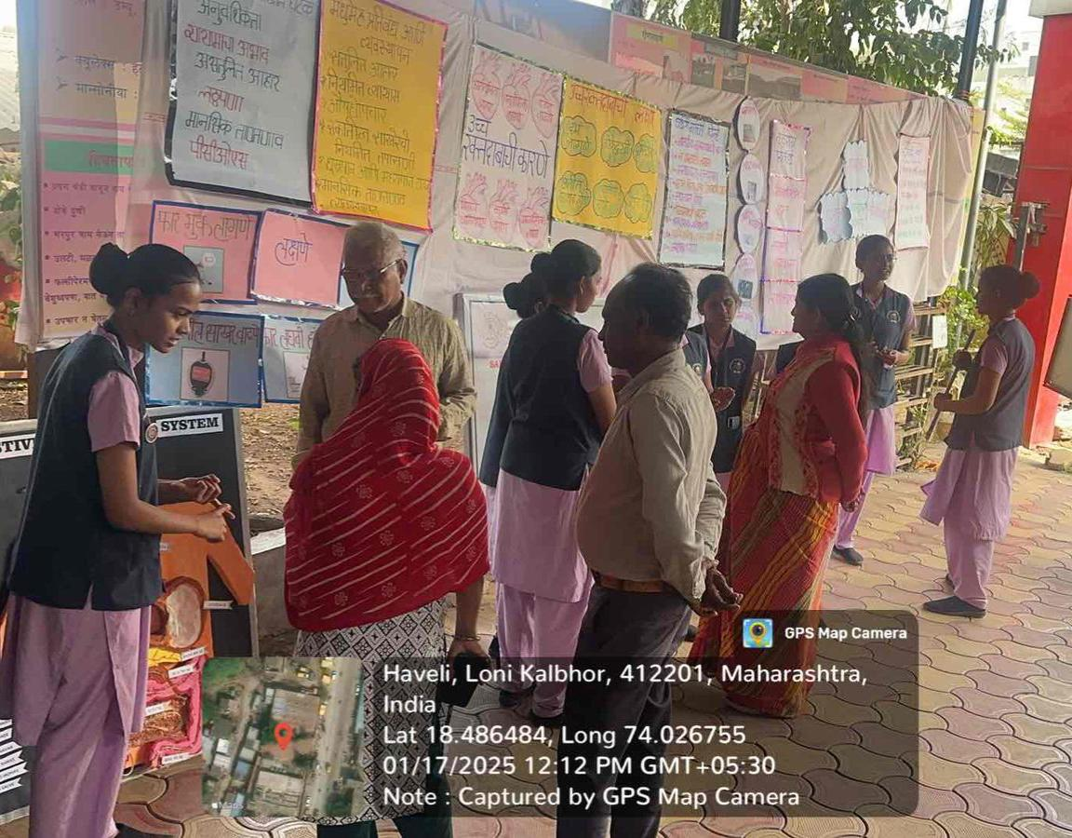
Exhibition at PHC on Non communicable diseases

Slide 20
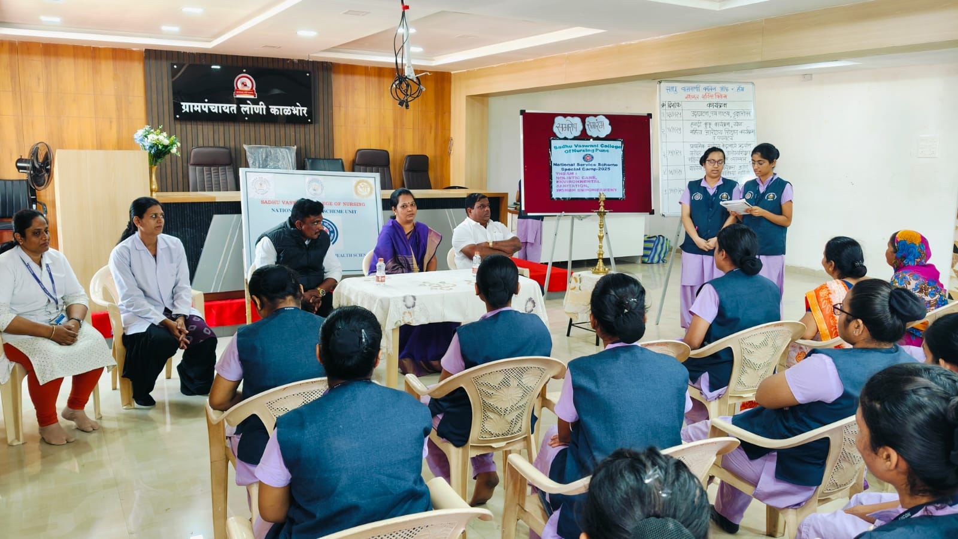
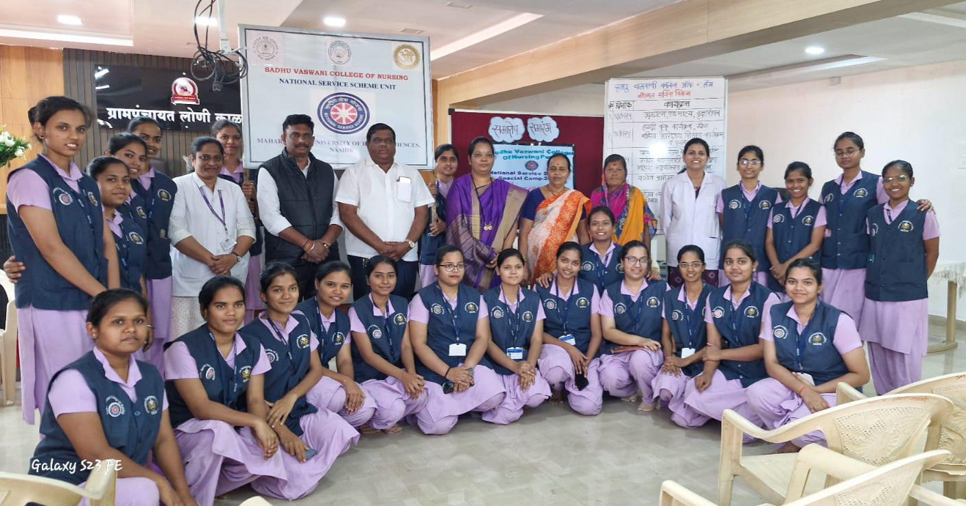
Day 7th -18/01/2025
Valedictory Program

Slide 21

REFLECTIVE
LEARNING

Slide 22



